Slide 1


Utah Women & Education
A Decade of Change
USBE Fall Conference
September 27, 2019
Robbyn Scribner
Assistant Director, Utah Women & Leadership Project
Utah Valley University

Slide 2

Purpose
The purpose of the Utah Women and Education Project (UWEP) was to lead efforts within the state to understand and then motivate more young women to enter and stay in school long enough to obtain college degrees.

Slide 3
Utah Women and Education Initiative (now part of Utah Women & Leadership Project)
The UWEI was designed to increase the number of Utah women holding postsecondary degrees and certificates, enabling them to more effectively:
contribute to the local, social, and economic development;
realize their own potential for positive influence to the public and private good;
influence and contribute in family, societal, and work contexts.

Slide 4


Study
Instrument
  Survey (quantitative)
  Interview-like (open-ended; qualitative)
245 participants
  Spent: 45 min. to 3 hours
  Average time: 1.5 hours

Slide 5

Study Limitations
Lack of participants in minority populations
Primarily LDS participants (80.5%)
Recruiting strategies (not random sample)
Perceptions (past, present, future)
Quantified qualitative data (coding)
True causality cannot be determined

Slide 6

Data Outline
  Value of Education
  Intentions
  Aspirations
  Values and Religion
  Family Background
  Schooling/Non-schooling

Slide 7


1. Value of Education
Utah young women do not generally understand the broad value of a college/university education
More educated – more value they see
Many benefits outlined in the brief were not mentioned by any young women
  Brief: “The Value of Higher Education for Women in Utah”
Literature: most of the benefits outlined come with degree programs (GE), not necessarily from certificate/training programs

Slide 8

Value of Education (2)
Many women stated that they do not need a college education because they “will not use it.”
Many say they do not want to go to college (or return) unless they know “exactly” what they want to do. For example, one states: “I don’t want to waste my time or money.”
Some participants assume that a number of their courses (GE primarily) are a “waste” because they do not teach them exactly what they think they need to learn.

Slide 9

Value of Education Categories
96.3% Economic/ financial
54.3% Knowledge/learning
40.8% Self-esteem/self-worth/self-knowledge
32.2% Better life/future opportunities
26.5% Self-development/self-improvement
26.1% Equity with men/respect for women
21.2% Independence
20.0% Teach children/example to children
14.7% Influence society/make a difference
11.8% Social benefits/improve social skills
9.8% Helping others
8.6% Competencies (e.g., critical thinking, problem
solving, community, decision making, human
behavior, tolerance of others)

Slide 10
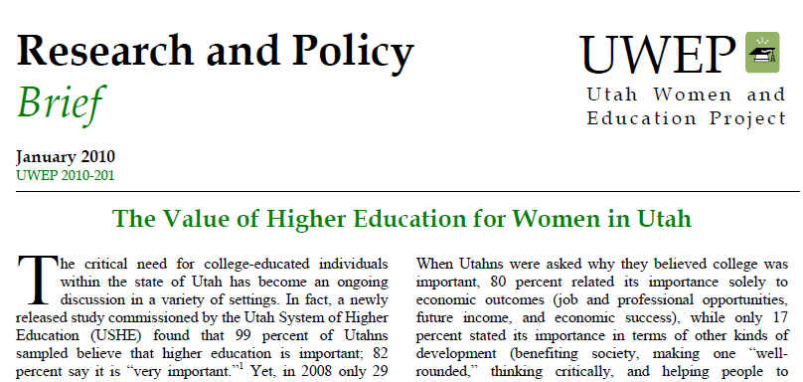
Value of Higher Education
Economic
Health & Wellbeing
Civic and Community Engagement
Parenting
Intellectual/Cognitive
Self-Development
There are 100s of benefits for work and life available by getting college educated!

Slide 11

Economic
Earn more money
Be better prepared to financially support self and family

Slide 12

Economic
Have better job opportunities
Gain access to better health care and related benefits
Have lower risk of unemployment

Slide 13
Poverty Rates
The 4% poverty rate for bachelor’s degree recipients was one-third of the 12% poverty rate for high school graduates.
The poverty rate for all associate degree recipients was 7%, compared to 9% for individuals with some college but no degree.
The 12% poverty rate for bachelor’s degree recipients living in families headed by unmarried females was about one-third of the 35% poverty rate for high school graduates living in similar families.
2008 Data

Slide 14

Health & Wellbeing
Live longer lives (on average)
Have an overall healthier lifestyle (exercise more, healthier diet, lower alcohol abuse, lower cholesterol levels, higher fiber intake, smoke less)
Are less overweight or obese

Slide 15

Health & Wellbeing
Have increased life satisfaction and overall happiness
Are more resilient and less depressed (better mental health)
Obtain more resources to pay for health insurance

Slide 16

Civic and Community Engagement
Participate substantially more in civic and community activities
  Voting
  donating blood
  filling leadership roles
Be a more conscientious civic and community volunteer

Slide 17

Other Social Benefits
Societies that have higher levels of education are safer; more educated individuals are less prone to commit criminal behavior.
For every year of increase in the average schooling level within a community, there is a 30 percent decrease in murder.
Communities that have a well-educated citizenry have fewer incidences of depression and suicide.

Slide 18

Parenting
Give birth to healthier babies
Spend more time reading to their children
Prepare children better academically for school
Have children who participate in extracurricular activities

Slide 19

Parenting
Provide healthier lifestyles for their children
Work higher paying, more flexible jobs
Have more college-educated children who can better provide for self and families

Slide 20

Parenting
Children of parents with higher levels of educational attainment are better prepared for school and, while in school, are more likely than other children to engage in educational activities with their parents.
Children between the ages of 3 and 5 whose parents had bachelor’s degrees were more than twice as likely as children of high school graduates to recognize all of the letters of the alphabet (39% vs. 18%).

Slide 21

Parents and Children
Parents with higher levels of education more frequently participate with their school-age children in a wide variety of activities, ranging from going to a library to participating in community/religious /ethnic activities, to attending concerts or other live events.

Slide 22
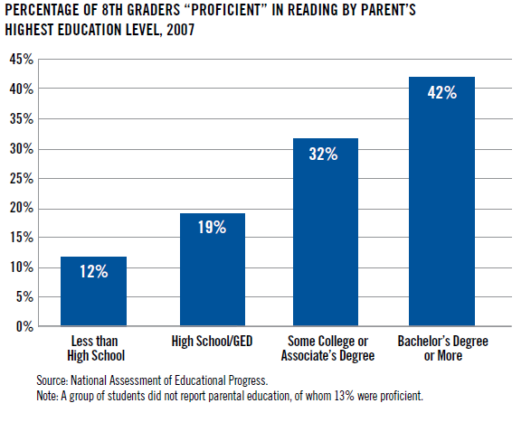
Reading Proficiency
Source: Goals for the Common Good

Slide 23

Intellectual/Cognitive
Better lifelong learning skills
More intelligence/knowledge (e.g., English, science, math, social sciences, reading)
Stronger teamwork and interpersonal skills

Slide 24

Intellectual/Cognitive
Increased ability to integrate ideas and concepts
Stronger writing and verbal skills
Higher critical and creative thinking, as well as decision making skills
Enhanced quantitative and analysis skills

Slide 25

Self-Development
Improved self-understanding
Greater independence and feelings of control in life
Superior leadership skills
Higher ethical and moral standards and reasoning

Slide 26

Self-Development
Stronger social skills
Better self-concept/self-esteem
Openness to diversity and racial understanding
Greater ability to make reasoned, reflective judgments
Stimulating occupations and increased quality of life

Slide 27
Takeaways
Young women need to be taught the broad value of higher education while young.
  Parents can teach this value.
  English teachers can give assignment to write about the benefits of a college education (GE included).
  Elementary school teachers can bring in guest speakers (parents) to talk about it and give assignments around this topic.

Slide 28
2. Intentions
Proactive College Activities Scale
Saved money for college
Discussed financial aid with someone (scholarships, loans, grants)
Requested information from a college
Visited a college campus
Applied to a college
Accepted or admitted to a college
Received a scholarship or grant to attend
Concurrent enrollment
AP courses

Slide 29
Commitment to Attend and Graduate
Saved money for college [1]
Discussed financial aid with someone (scholarship, loans, grants)
Requested information from a college
Visited a college campus [2]
Applied to a college
Accepted or admitted to a college
Received a scholarship or grant to attend [3]
All are linked to attending and graduating from college

Slide 30
Takeaways
Children and youth need to be encouraged and assisted in saving money for college.
Influential individuals should provide opportunities for girls and young women to visit college campuses.
Young women should be encouraged to take concurrent enrollment, AP, and other college preparation courses during high school. The specific reasons for this should be explained clearly.

Slide 31
3. Aspirations
Key Finding throughout Study
Analysis of qualitative results found that young women believe they are being encouraged to go to college or attend college—not necessarily to graduate from college.

Slide 32

Perceptions
All but three said that getting more education is important/wonderful
Lack of urgency
Nearly all women who do not attend or who drop out truly believe they will get their degrees in the future.

Slide 33
College Degree Sometime in Life?

Slide 34
Which Level of Degree?

Slide 35

Disconnect
Questions: goals/aspirations
Only 50% discussed plans to earn an associate degree or higher

Slide 36

Conversations/Age of Decision
The younger the conversations started and a girl/young women made the decision to attend college, the more likely she was to…
  Have a higher commitment to attend college/graduate
  Actively preparing for college
  Desire for a higher degree level
  Saving money for college
  Having parents who are more encouraging and supportive

Slide 37
4. Values and Religion
What does your religion teach you about continuing your education after high school?
What message do you think are given from your top church leaders (e.g., Pope, prophet) about women earning college degrees?
**Do your local church leaders (e.g., youth leaders, bishop, rabbi, minister) talk to you about your education? If so, what do you think they are encouraging you to do with your educational and career choices?

Slide 38
Religious Teachings
What does your religion teach you about continuing your education after high school?

Slide 39
Top Church Leaders
What messages do you think are given from your top church leaders (e.g., Pope, prophet) about women earning college degrees?

Slide 40
Local Church Leaders
Do your local church leaders (e.g., youth leaders, bishop, rabbi, minister) talk to you about your education? If so, what do you think they are encouraging you to do with your educational and career choices?

Slide 41
Findings (1)
Some say if they were more active in the LDS faith, they would probably have attended college.
Many talk of the importance of attending college, but not necessarily about graduating.
Many see no urgency; they believe they will finish “someday.”
Marriage (or sometimes when a child is born) is the end of college for many women. Many believe that women need to “give up” or “sacrifice” their college for the family. It is their “duty” to drop out of school.

Slide 42
Findings (2)
Many cannot see a situation where they can be married, have children, and continue college. It is all or nothing. They cannot see a life of integration. They do not see options.
Education is the top priority for many until marriage, and then priorities change quickly. Education doesn’t just slide to second priority—for some it falls totally off the priority list.
Education gets lumped together with “work”; a “faithful LDS woman” stays home with her children (that means no outside work or education).

Slide 43
Perception of Teaching
My religion teaches education is not merely a good idea, it’s a commandment. We are to learn of things of both in the heaven and in the earth. They say it’s important to strive, learn and study in our lives and seek knowledge from the best books. They encourage getting education but do not expect us to get a degree.

Slide 44
Church Encouragement
I feel like my religion (LDS) strongly encourages continuing education after high school. Our church teaches that knowledge is the only thing you take with you when you die (not cars, homes, etc.). I believe this, and that is partly why I went to college. Women are also encouraged by our church leaders to earn a college degree. Family is extremely important in our church, but the top leaders strongly encourage women to gain an education so they can teach their children and help support their families.

Slide 45
Youth Leaders
My local church leaders, especially my youth leaders, talked quite a bit to me about my education. I remember after my first week of college I had a breakdown and wanted to quit. I went and visited one of my youth leaders and she shared a similar experience that her daughter had, and promised me that if I hung in there, it would get better. She gave me advice on things I could do to help make my college experience more enjoyable. I listened to her advice and she was right. I was fine after that.

Slide 46
Religious Activity
Religious activity is a strong predictor of the following (in various models):
  Attendance and graduation
  Proactive college scale
  Total leadership
  High school GPA
  Age of decision
  Father encouraged and/or supported
  Mother encouraged and/or supported

Slide 47
Takeaways
Local church leaders play a particularly important role in encouraging young women to attend and graduate from college (all religious variables were linked).
Efforts should be made to discuss how young women can integrate marriage, family, and college.
Realistic data (e.g., divorce rates, economic challenges) should be presented in church settings so that young women understand the importance of completing degrees and the importance of family.

Slide 48
5. Family Background
The higher the level of a father/mother’s education, the more likely their daughter will…
  Prepare for college.
  Attend and graduate from college.
  Receive more encouragement and support to attend.
  Develop a love for learning
  Have parents who read to her, help her with homework, develop activities, and attend learning and cultural events.
  Have parents who set a positive example of gaining knowledge and learning.

Slide 49
Father
My father has helped me develop a deep love for learning. I remember when I was in 2nd grade I had an obsession with reading; my dad would suggest books to me, and sometimes even read the books at the same time as me so that we could discuss the plots. I remember always trying to read as quickly as he would when we were reading books at the same time so that he wouldn't have to wait for me to turn the page, of course, he didn't really mind waiting for me.

Slide 50
Influence of Fathers
I think my father tried to ruin learning for me. He made fun of me when I got put in a special reading class because I didn’t know how to read, and when I learned to love to read, he would take my books away. When I was in 5th grade, he grounded me for 4 months from doing everything but multiplication tables; he wanted me to be able to do them all in 30 seconds, 1-12. Which, I did, but now I can hardly remember any of them. I don’t talk to my father anymore, he was a jerk, and I don’t want anything to do with him.
At dinner, my dad would ask each of the kids what we learned that day in school. We not only had to tell what we learned, but express understanding of the subject.

Slide 51
Mother’s Influence
When my mom went back to school and earned her Bachelor's Degree it just influenced and empowered me even more, and now I know that I can go back and accomplish that too.
She has been a seamstress her whole life. She often encouraged me to go to college, and was a living example of what happens when you do not get a good education.
My mom knows college is important, and every day she regrets not finishing so that she could accomplish her dream. She regrets that decision and knows that she would have chosen differently if her parents had shown more encouragement while she was growing up.

Slide 52
Percent Parents Agreed to Pay
Percentage of College Costs to Pay | Percentage of Women Participants
None | 53.1%
25% of college costs | 15.1%
50% of college costs | 12.7%
75% of college costs | 8.6%
100% of college costs | 9.8%

Slide 53
Financial Support
I have always known that there is absolutely no way my parents can pay for my college. It's up to me and good old financial aid. I have never even brought it up, because it is something that is already answered by our financial situation.
My dad even told me that he would help after I got married to be sure that I would finish and not drop out because I couldn't afford it.
I knew there was no way they could afford it, but they helped me apply for many scholarships and grants.

Slide 54

Schooling/Non-Schooling
College preparation during high school
High school leadership
High school activities
Time spent in high school
GPA
Schooling experiences
People in school (counselors, teachers, administrators)
Friends and peers
Other influential individuals

Slide 55

College Prep During High School
Qualitative results outline the most influential college preparations activities during high school:
    College fairs/career fairs (individual conversations with people from colleges)
    Field trips to college/universities
    Presentations in classes (e.g., English)
    Assemblies
    SEOP
    Published information (e.g., brochures, pamphlets)
    Assessments (comment about middle school)

Slide 56
Takeaways
Schools can host college fairs and provide opportunities for students to take fields trips to campuses.
Efforts can be made to emphasize a strong high school GPA, with college as a goal.
Efforts can be made to encourage participation in activities that provide leadership opportunities.
Young women can be encouraged to join school clubs and volunteer in their communities.
Working too many hours for pay may result in less likelihood of attending and graduating from college.

Slide 57


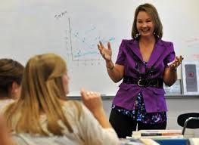
People in School
Administrators
Counselors
Teachers
Coaches and club advisors

Slide 58
Quotes about Administrators
My principal really made me feel excited about the idea of going to college. He encouraged me to do my best, and to keep going. I think one of the biggest things that made an impact on me was that he was willing to learn who I was by name, my situation, and he took the time to give me advice.
Not a lot of administrators had interest in my education.
My assistant principal told me that I basically couldn't be a teacher someday because it was a very difficult job.
My school's administrators were apathetic towards me and felt like there was no point in talking with me since my attitude was so discouraged.

Slide 59
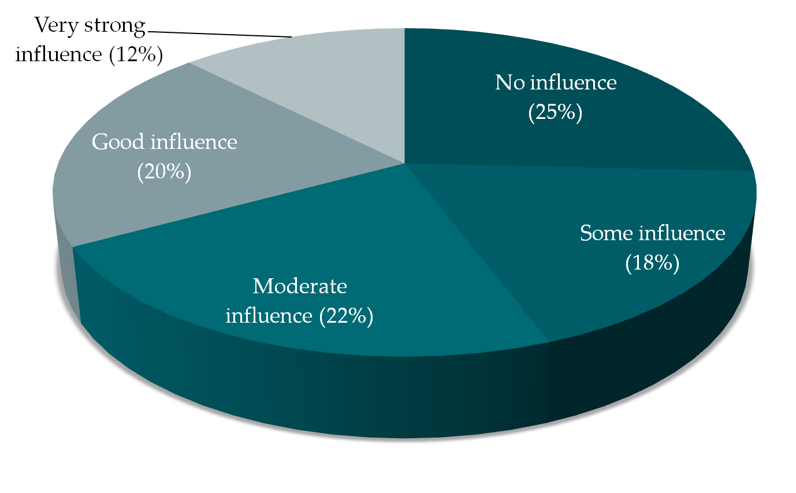
High School Counselors

Slide 60
Disturbing Quote
The counselor in High School talked about my goals for college (with my mom there). He asked what I wanted to be, and I told him veterinarian. He then pulled up my grades (3.4 GPA average) and told me that I should not waste my time being a veterinarian because I did not have the grades for it. That was devastating to hear, and I believed him.

Slide 61
Quotes about Teachers
The most influential person at school for me was a teacher I had. He told me that I could go to any college I wanted, and they would be lucky to have me. He really motivated me to do well in school and reach for my potential.
I didn't really have anyone talk to me about college.
I had one teacher who was really influential about college. She wanted us to go and learn so much. I felt like it was her passion to teach us and let us know what we could have. I loved her because she cared so much for us.

Slide 62
Quotes about Teachers
The worst part of high school was when I had more than one teacher tell me that I would never go anywhere in life, never amount to anything and never succeed. I know they say sticks and stones will break your bones but words will never hurt you, well, they do, and they totally hurt me. It took a while to shake off those hurtful things that were said to me, but I powered through everything and then ended up getting super good grades my junior and senior year.

Slide 63
Coach
I was a statistician for the wrestling coach who was also my English teacher. He was another great influence on me. During my MATC schooling my senior year we had to prepare a career packet which consisted of a resume and a referral letter from an adult. He was obliged to provide the letter for me and after reading it, I realized how much confidence he had in my abilities to learn, and be a wonderful contributor to society. This one letter provided me with the confidence and self worth I had been struggling to find for years.

Slide 64
Conversations
Family
  Parents
  Siblings
  Relatives
School
  Administrators
  Counselors
  Teachers
  Coaches and club advisors
Others
  Friends
  Local church leaders
  Employers
  Neighbors
  Family friends
  Church/community members

Slide 65
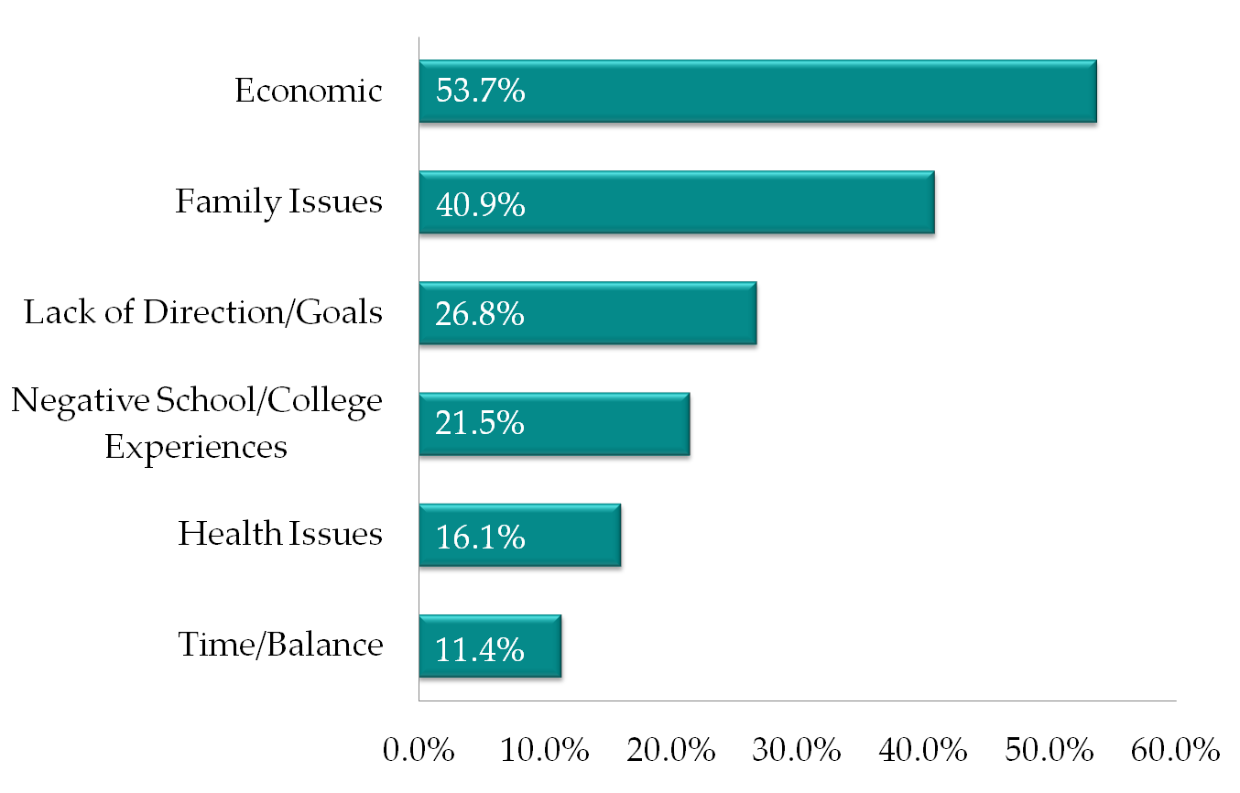
Why Did You Not Attend College?
Utah Women and Education Project Research Findings

Slide 66
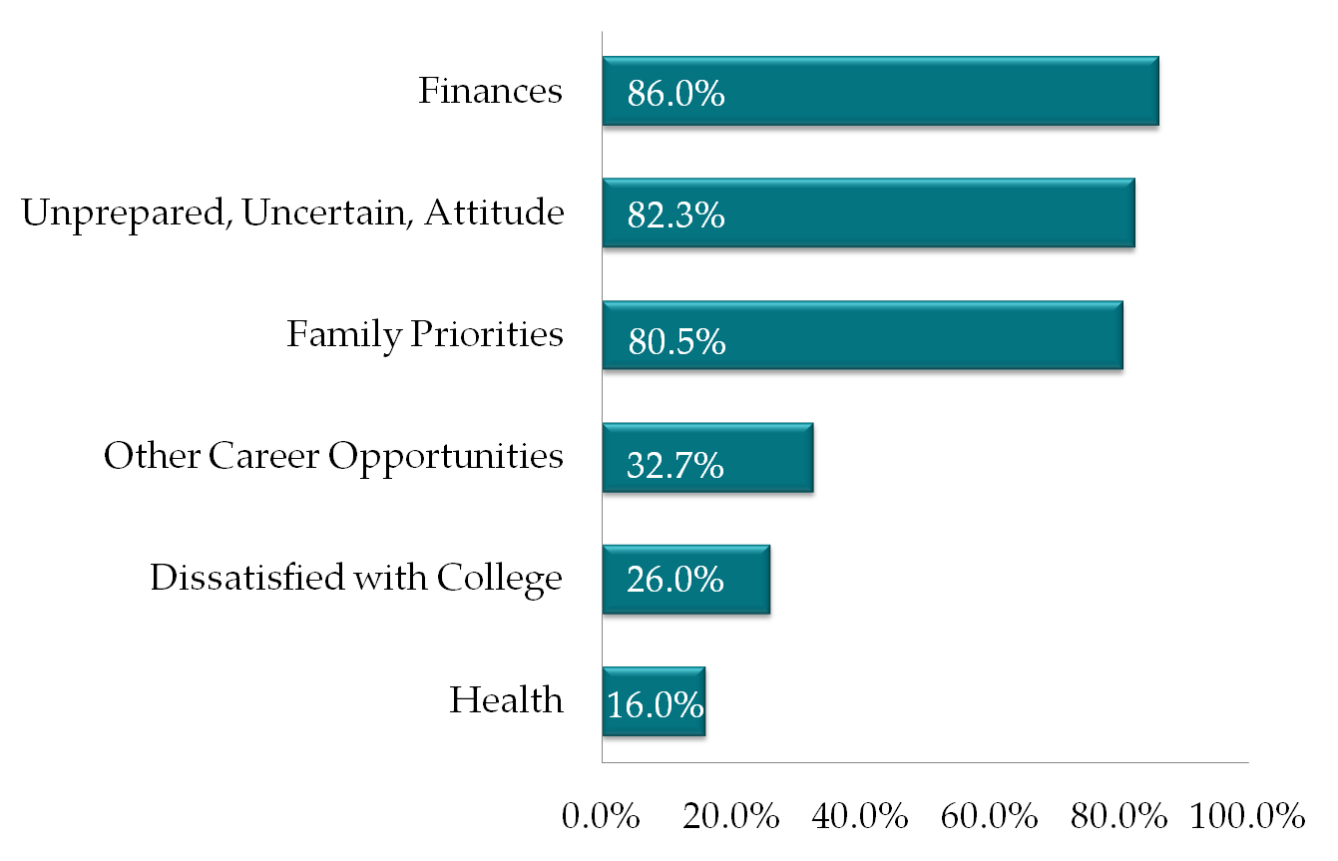
Why Did You Not Continue?
113 who fit into this category

Slide 67
Employment Facts for Utah Women
61% of Utah women have paid employment.
61% of mothers with preschool children work.
73% of mothers with school aged children work.
A young woman today can expect to spend more than 30 years in the labor force.
Source: U.S. Census 2015 data

Slide 68
Employment Facts for Utah Women
Utah has one of the largest wage gaps in the nation.
Utah women are less likely than U.S. women to work in jobs that require higher education.
Over 40% of employed Utah women work in 2 job groups that pay less than the median state wage for all jobs.
Utah men earn more than women who have achieved a higher level of education.

Slide 69
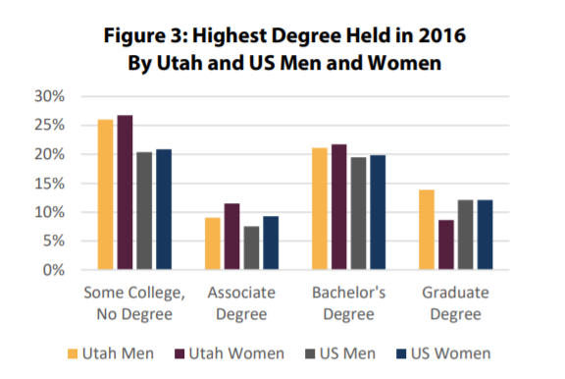
Utah Women in Higher Education: A Progress Report, 2018

Slide 70
Key Findings
1) Utah women pursue shorter programs and lower-paying fields of study than Utah men;
2) Utah women face unique barriers to persistence, and these explain a greater discrepancy between enrollment and completion compared to Utah men (a higher percentage of Utah women have started but not finished a bachelor’s degree compared to Utah men, US men, and US women); and
3) Utah women represent more than half of enrolled students at degree-granting institutions.

Slide 71

Some College, No Degree
Utah women are 2nd in the nation in this metric (behind Idaho).
27.7% of Utah women have some college, no degree, verses 21% of US women generally.
We are good at starting college! Not all Utah women are great at finishing college (even a lower level degree).

Slide 72
Key Findings
Among adults with at least a bachelor’s degree (including those who have earned graduate degrees), Utah women rank lower than Utah men, US women, and US men even though these differences are decreasing over time. This metric, and the association between higher degree levels and higher wages, greater job flexibility, and greater job satisfaction, likely contribute to Utah’s poor outcomes in national comparisons of women’s equality and opportunity.

Slide 73
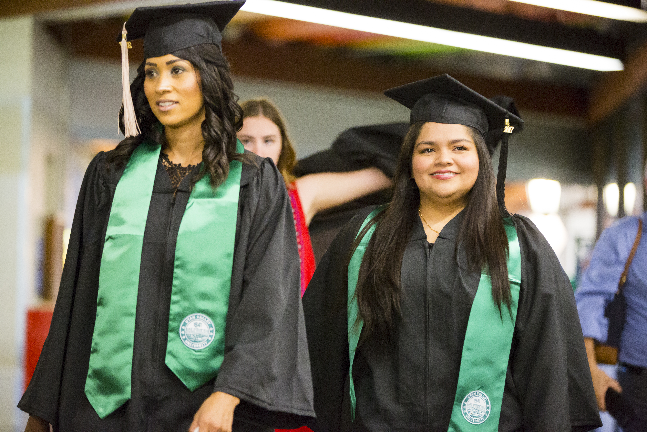
Utah Women still lag US Women
Nationally, women represent a greater share of enrollees and have higher degree attainment.
Utah women earn lower-level degrees, pursue lower-paying and stereotypically-female fields of study, and have poorer economic outcomes compared to US women.

Slide 74
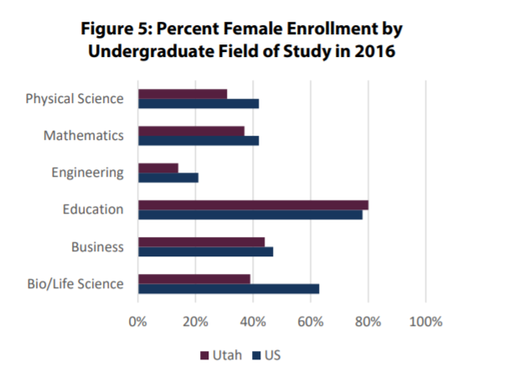
Utah Women still lag US Women

Slide 75
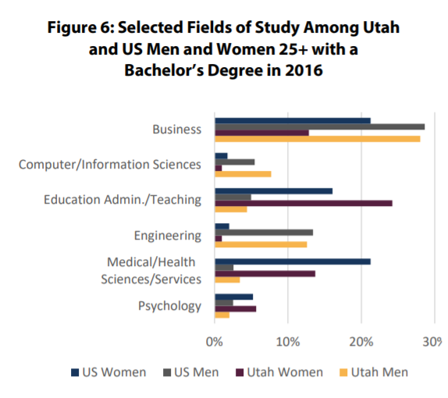
Utah Women in gendered fields

Slide 76
Changing Expectations
A greater percentage of women completed an associate degree than had intended (38.5% versus 31.0%).
Additionally, though the percentages of men and women intending to earn a bachelor’s degree were nearly identical in their first term, about 51% of men who completed a certificate or degree by 2017 had earned a bachelor’s degree compared to 44.7% for women.

Slide 77
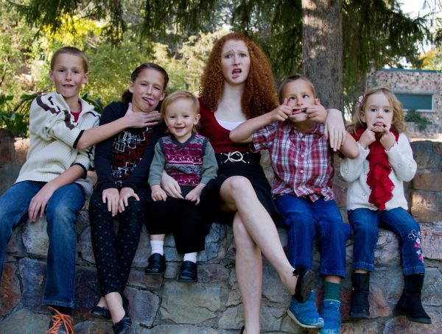
Family Dynamics
Both men and women are less likely to be enrolled in postsecondary education if their household includes their own children who are less than five years old, but this association is more than as strong for women.

Slide 78

Family Dynamics
Women who are married are more likely to have lower educational attainment. Family formation is associated with lower postsecondary education behavior and attainment for women in Utah.
Men who are married are more likely to have graduate degrees (compared to other attainment levels).

Slide 79
Supporting Utah Women
We need to provide support to parents (especially mothers) of young children who are pursuing postsecondary education.
We need to create and advertise family-friendly work policies in all occupational fields.
Women pursue lower-paying fields of study because they hope for flexible employment in the future (such as working only while children are in school), but these fields are linked to poorer economic outcomes. In reality, however, workers with more education tend to have more workplace flexibility and autonomy.

Slide 80

Looking ahead
USHE analyses show that in most institutions the distribution of men and women across fields of study is becoming more diverse over time.
Yet, Utah women’s postsecondary educational attainment is still gendered by program length and field of study—both of which are linked to less favorable economic outcomes.

Slide 81

Taking Action
What can each of us do in our role to better understand and impact the state of women’s higher education in Utah?
What tools and resources do we need to take action and lead change within our own sphere of influence?
Who do we need to educate and inspire to join us in our efforts?

Slide 82


Conclusion
Formal postsecondary education is a critical foundation for Utah girls and women of all ages to be able to fully develop themselves toward reaching their inherent potential. All of us can assist in some way to help more young women in Utah do just that!

Slide 83

Thank you!
Robbyn Scribner, Assistant Director
Utah Women and Leadership Project
rscribner@uvu.edu
Dr. Susan R. Madsen, Founder and Director,
Utah Women and Leadership Project
Utah Valley University, Woodbury School of Business
madsensu@uvu.edu

